Slide 1

The SI Guyz
SI 206: Angel Ranjel, William Luna, Hamza Asad
Final Project

Slide 2
Abstract
Notes:
allie

Slide 3

Goals of our Investigation
“Music is itself life”-Louis Armstrong
Music is something that is heavily proliferated and an integral part of all cultures.
According to an article from MNE
“Americans are listening to more new music during coronavirus pandemic, new study says”
Music video streams have also increased by 10 per cent
https://www.nme.com/news/music/people-are-listening-to-more-new-music-during-coronavirus-pandemic-new-study-says-2667098
Notes:
Allie

Slide 4

Goals of our Investigation(Cont’d)
We were initially interested in investigation whether we could extrapolate any data in regards to consumption patterns of music during the COVID pandemic.
Upon further investigation, however, we realized we didn’t have access to that kind of data with the publicly available spotify API.
The focus of our investigation thus shifted to whether we could find any general trends in regards to the top performing songs in the Covid era.
Additionally, we were concerned with the proper demonstration of API,Beautiful Soup, Webscrapping, and Database calculations
Notes:
Allie

Slide 5
Accomplishments/Goals Achieved
Notes:
allie

Slide 6

Accomplishments
Successfully:
Interacted with Spotify and Genius API.
Created Database programs and utilized them for calculations.
Notes:
Allie
They sell a selection of vodka, gins and other alcohols. Craft cocktails at bar

Slide 7

Accomplishments(Cont’d)
Successfully:
Scrapped Billboards website using HTML parser to extract data.
Visualized Extrapolated data using Matplotlib.
Observed general trends in regards to the Top 100 Billboard songs.
Notes:
Allie
They sell a selection of vodka, gins and other alcohols. Craft cocktails at bar

Slide 8
Problems We Encountered
Notes:
allie

Slide 9

Problems
We had to alter the initial scope of our investigation, as we were not granted access to the data we required through Spotify’s public API.
We experienced severe issues dealing with the varying tags when transitioning from the Spotify to Genius Api.
This was a multi-faceted dilemma that took considerable time to resolve.
Notes:
Allie
They sell a selection of vodka, gins and other alcohols. Craft cocktails at bar

Slide 10

Problems(Cont’d)
Familiarizing ourselves with Spotify API and web server took considerable time as well.
Extracting JSON from Spotify and Genius API was a learning curve.
SQL was repeatedly not connecting to server for one of our groupmates causing them to have to reinstall Anaconda.
Notes:
Allie
They sell a selection of vodka, gins and other alcohols. Craft cocktails at bar

Slide 11
Calculations from Database:

Slide 12
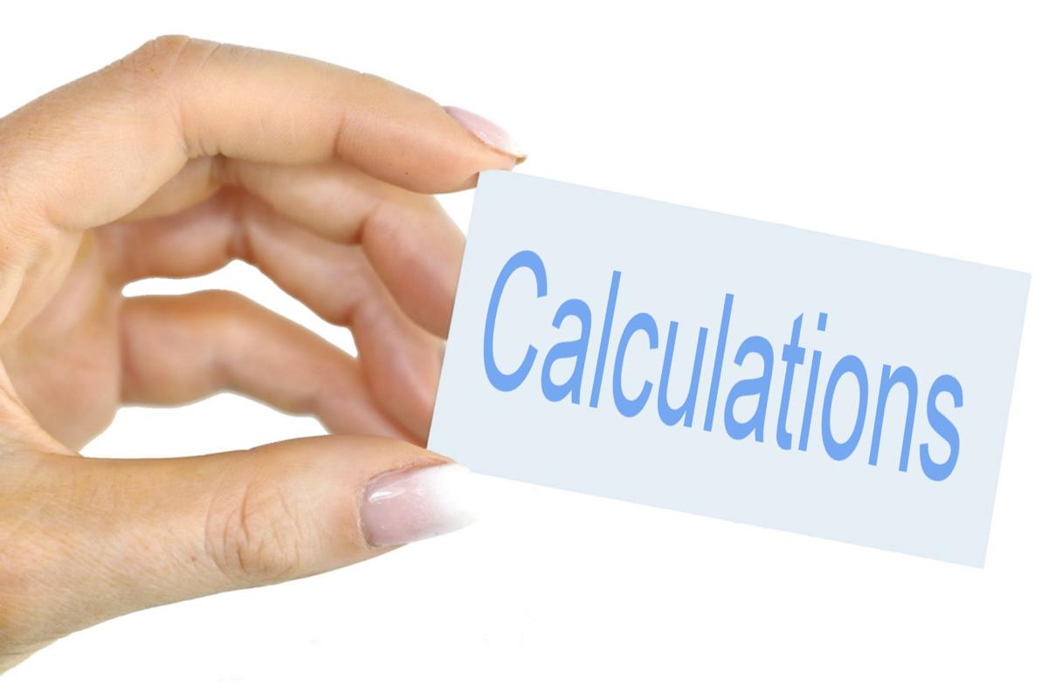
What We Calculated
1. Average words of song in playlist
2. Average popularity for songs in playlist
3. Average time for songs in playlist
4. Average popularity of most popular songs above 70

Slide 13
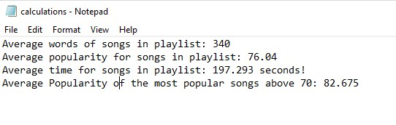
Our Calculations Visualized:

Slide 14
Visualizations Created:

Slide 15
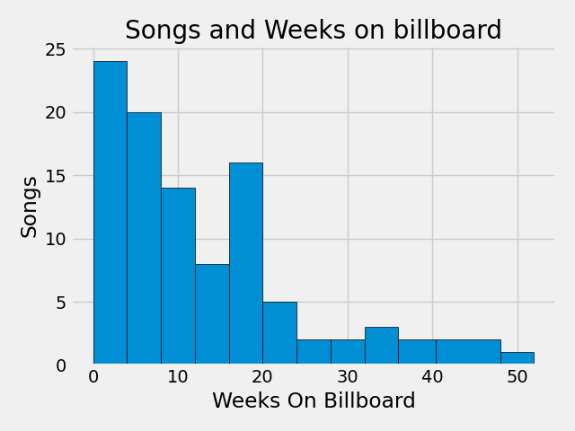
Figure 1
One of the general trends we wanted to observe is how long songs remained on the Top 100 Billboard.
As one will note most songs remain on the billboard anywhere between 0-4 weeks.
Generally speaking its harder for songs to maintain popularity over time.
Only one song was on the Top 100 Billboard fro greater than 52 weeks(1 year)

Slide 16
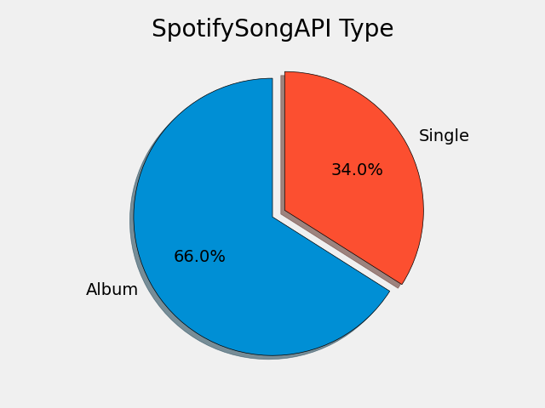
Figure 2
We wanted to investigate whether most of the songs on the Top 100 Billboard were singles or albums.
It turns out most of the songs were part of Albums.

Slide 17
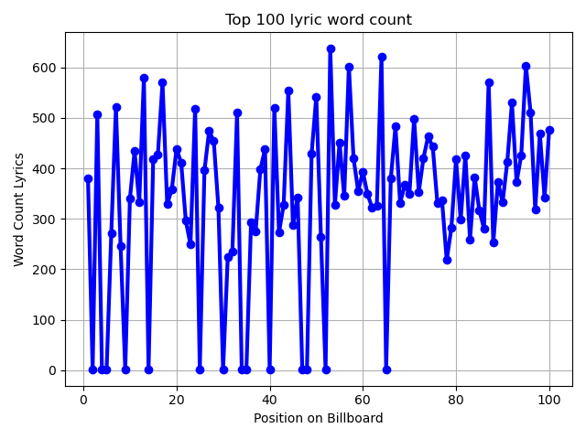
Figure 3
One of the things that we were interested in measuring was if there was a correlation between the song’s position on the billboard and its word count.
The unfortunate issue we encountered is that some of the songs we did not could not get the lyrics for so there word count came out as 1.

Slide 18
Figure 4
For Our next graph we wanted to determine which artists performed the best.
We did this by determining which artists had multiple songs on the Top 100 Billboard and using that data to make a bar graph.
Bad Bunny had the best performing year as he had 10 songs on the billboard.
See Graph on Next slide.

Slide 19
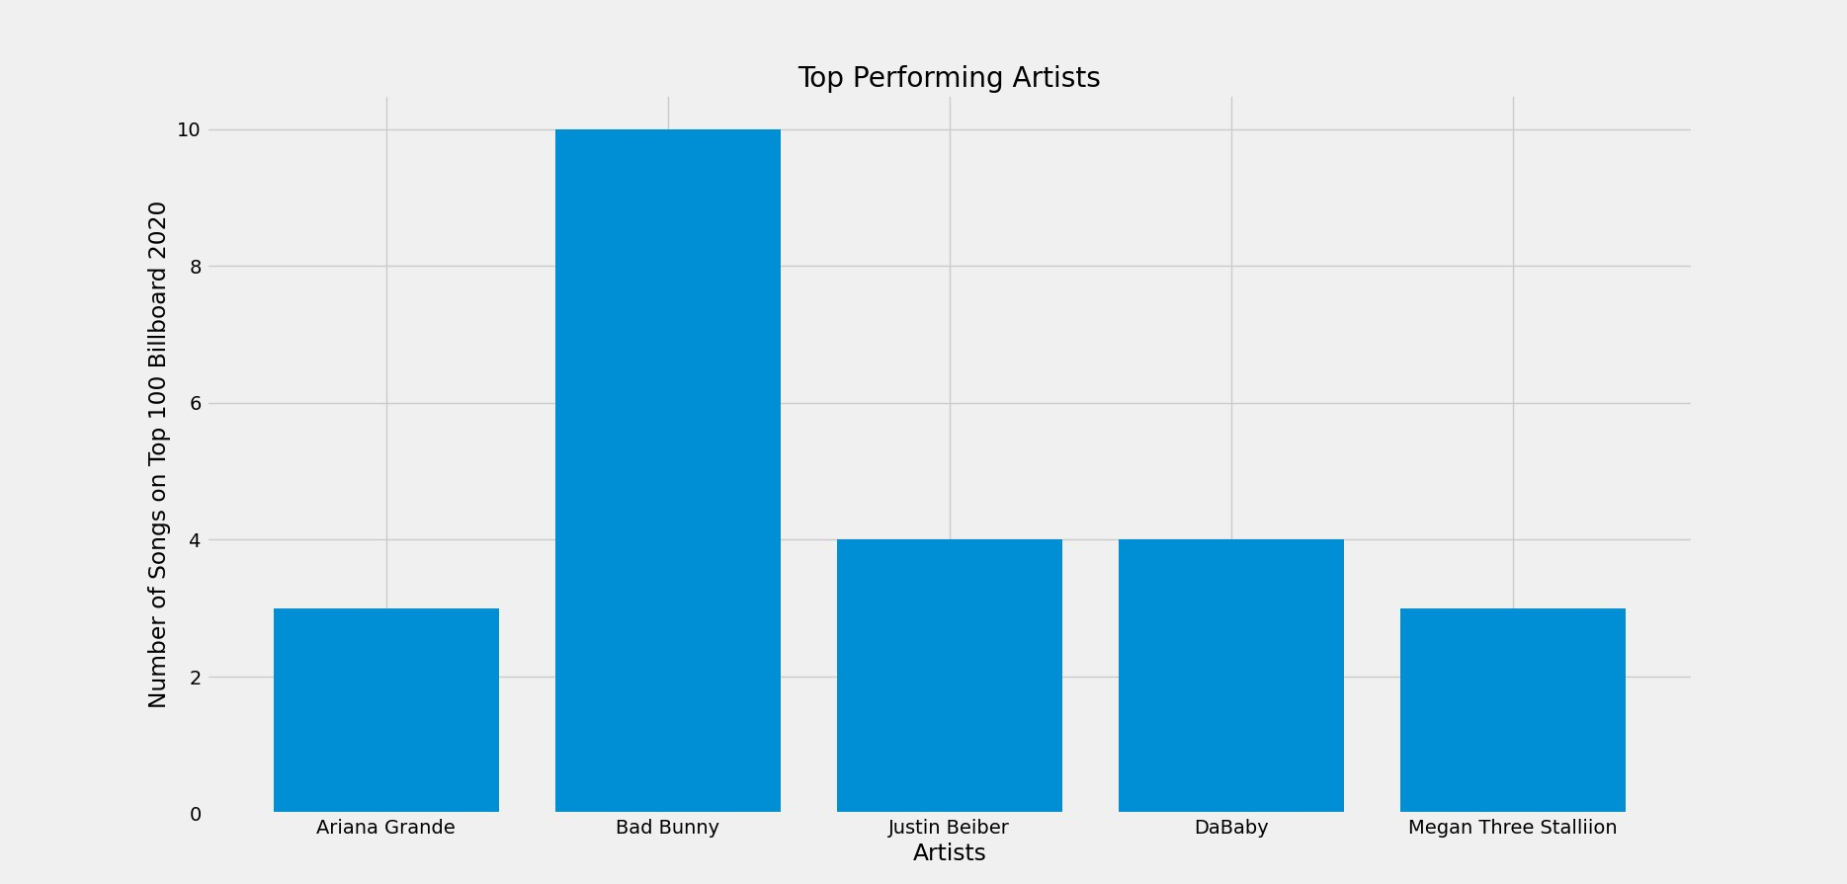
Figure 4

Slide 20
Figure 5
For the final Graph out of all the artists who had multiple songs on the Top 100 Billboard, we wanted to determine the average word count of the lyrics.
We graphically represented this with a bar chart and found that Da Baby on average had the longest songs at least in terms of word count.
See Graph on Next slide.

Slide 21
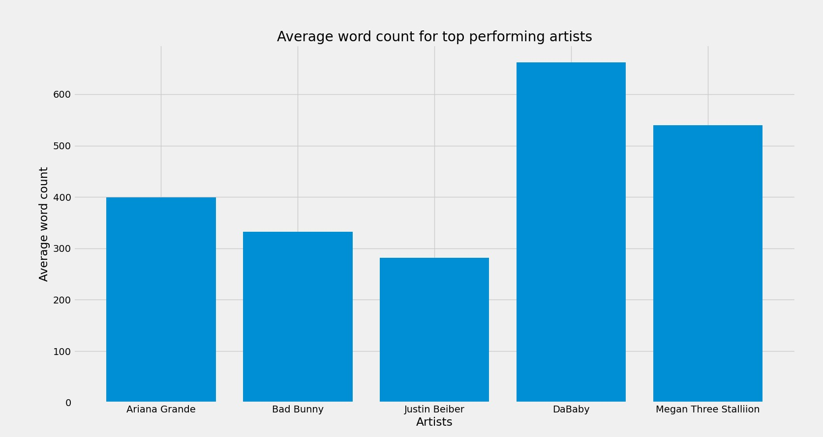
Figure 5

Slide 22
Instructions for Running Code

Slide 23
How to Run Code
Our Project Layout:
Within our folder we have a BeautifulSoup file, A separate file for both our Genius and Spotify APIs, and a music stats database.
Run Code:
You will have to change the directory in the code to run locally in:
Line 57 of the BeautifulSoup.py
Line 142 and 178 of GeniusAPI.py
Line 69 , 103, 188, 242,and 278 of the Spotify API
First run Genius API 4 times to get the full database.
Next run SpotifyAPI and BeautifulSoup 4 times as well.

Slide 24
Documentation Of Each Function

Slide 25
Genius API.py

Slide 26
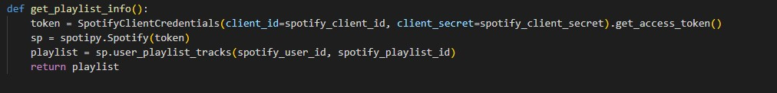
get_playlist_info()
This Function imports the spotipy library to facilitate usage of the Spotify API.
We contacted the Spotify API using our Client id’s and secrets.
This Function returns a response from the Spotify API using the spotify_user_id and spotify_plyalist_id.

Slide 27
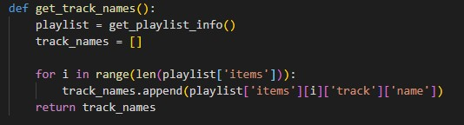
get_track_names():
This function uses the playlist json response and searches for track name and returns a list list of track names.

Slide 28
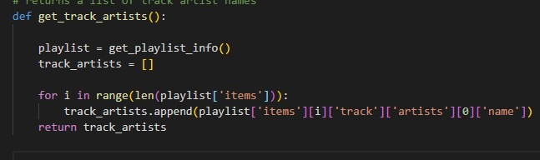
get_track_artists():
This function uses the playlist json response and searches for track artist names and returns a list of track artist names.

Slide 29
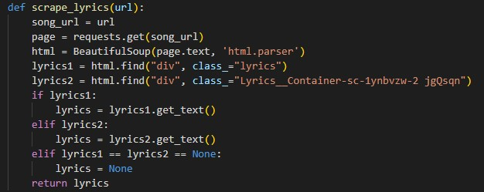
scrape_lyrics
This function takes the url found in the response returned from the genius API.
With the url the function scrapes the web for the song lyrics using Beautiful Soup.

Slide 30
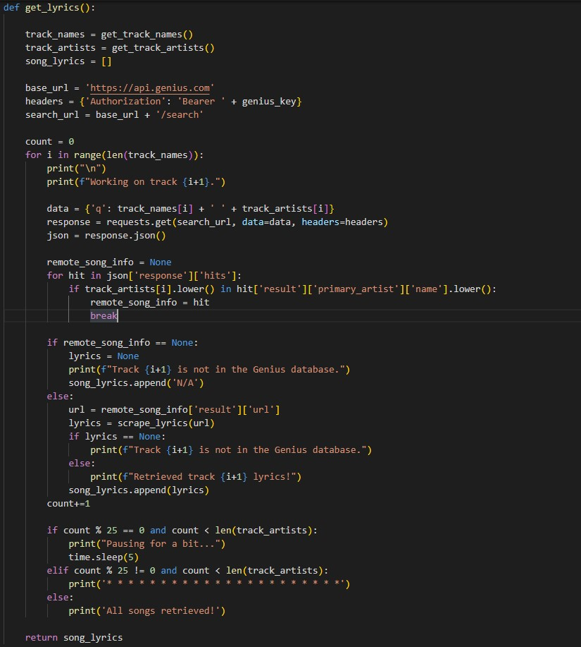
get_lyrics
This function uses track names, artist names, and the Genius access token(key) teo get a response from the Genius API.
From the response we retrieve the URL to web scrape the Genius website and return the song lyrics.
We used a series of conditionals and try/except clauses to catch any failed web scrape attempts or a return of empty lyrics. Also included is a sleep timer.

Slide 31
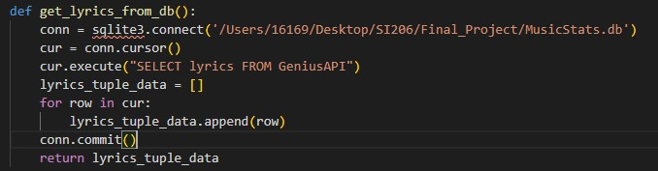
get_lyrics_from_db()
This function selects all the lyrics data from the Genius API database table and returns a tuple list of the lyrics.

Slide 32
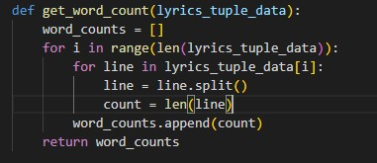
get_word_count()
This function takes the lyrics tuple data and iterates through the lyrics.
It then returns a list of the word count for each song in the database.

Slide 33
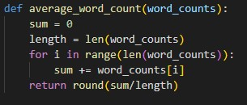
average_word_count()
This function takes the word_counts list returned from the lyrics data and calculates the average word count for all the songs.

Slide 34
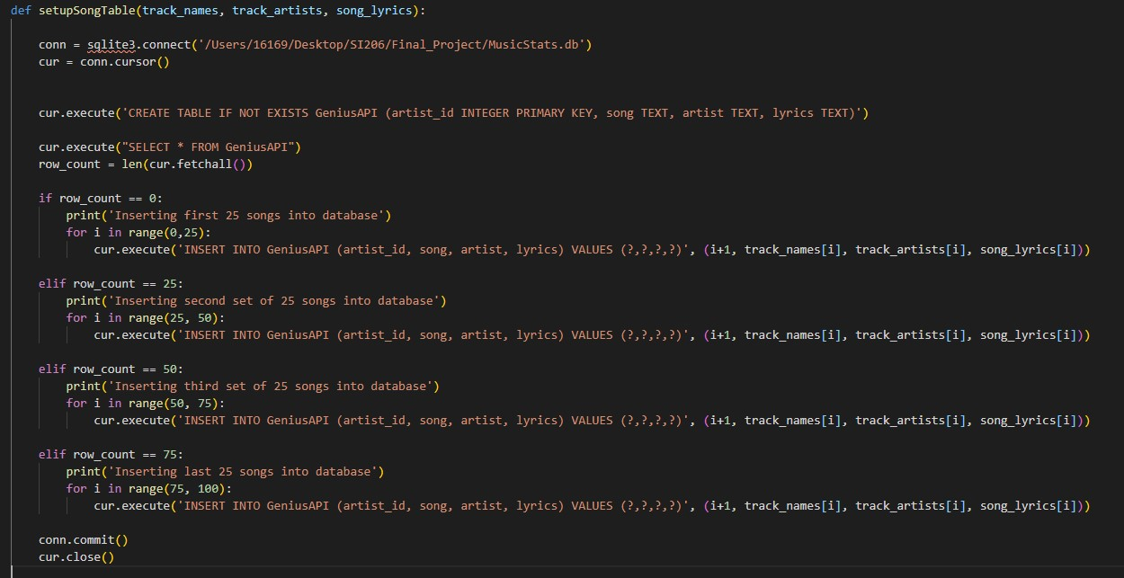
setUpSongTable()

Slide 35

setupSongTable() (Cont’d)
This function takes a track names list, a track artist list, and a song lyrics list to create the Genius database table.

Slide 36
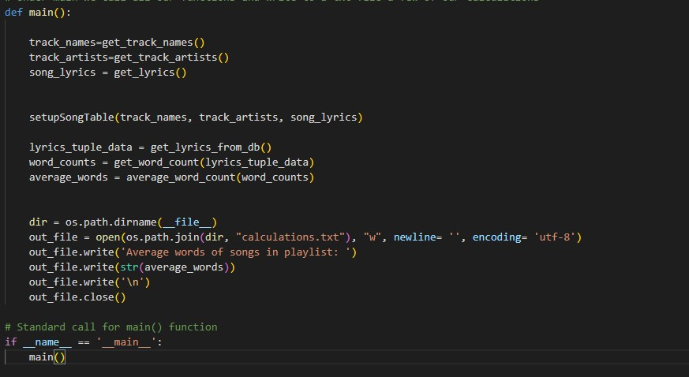
Main

Slide 37
Main
Under main we call all our functions and write to a text file a few of our calculations.

Slide 38
Spotify API.py

Slide 39
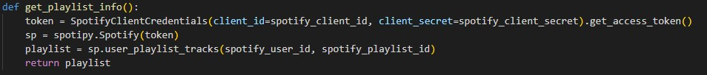
get_playlist_info():
Our Project Layout:
We Imported the Spotify library to help us use the Spotify API with a few Spotipy functions..
We contact the Spotify API using our clients id’s and secrets.
Return a response from the Spotify API using the spotify_user_id and spotify_playlist_id.

Slide 40
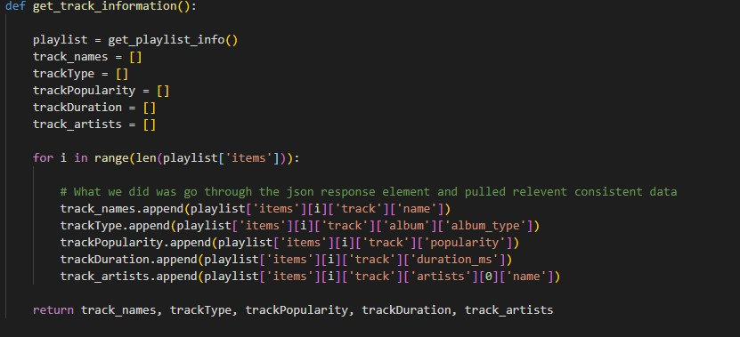
get_track_information():

Slide 41
get_track_information(): Cont’d
This Function condenses alld data requests from Spotify API json response into one function.
We access track name, album type, popularity, and duration in ms.
Track artist names into appropriate lists and return them.

Slide 42
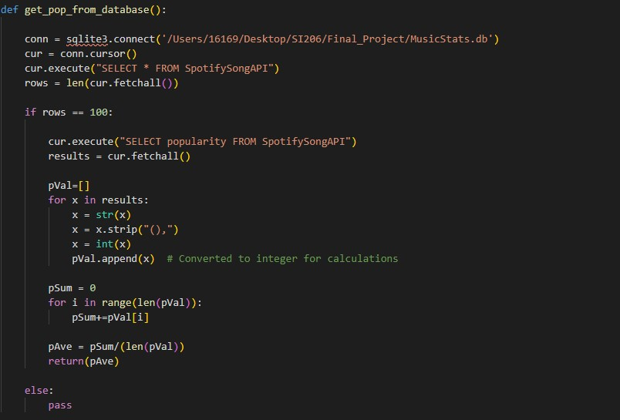
get_pop_from _database():

Slide 43
get_pop_from _database(): Cont’d
This function selects the popularity data from the SpotifySongAPI table and returns the popularity tuple list.
It then calculates the popularity average by converting the tuple data into integers.
It then returns the popularity average.

Slide 44
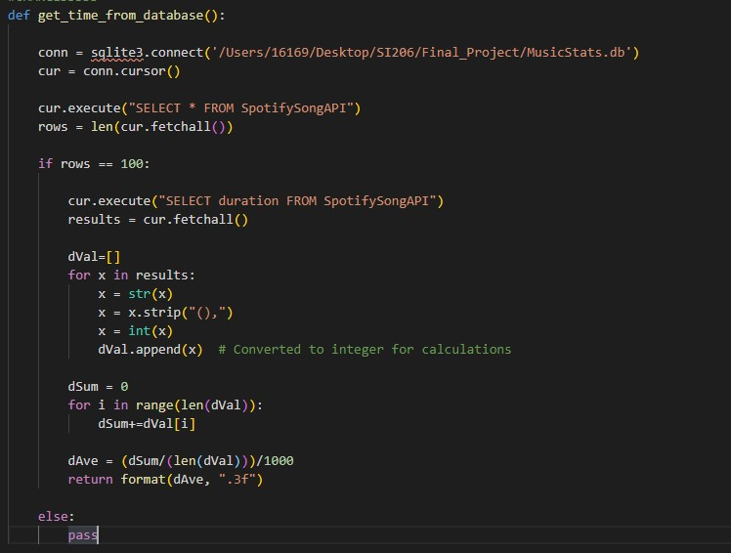
get_time_from _database():

Slide 45
get_time_from_database(): Cont’d
This function selects the song duration data from the SpotifySonggAPI table and returns the duration tuple list. It then calculates the duration average by converting the tuple data into integers.
It then returns the duration Average.

Slide 46
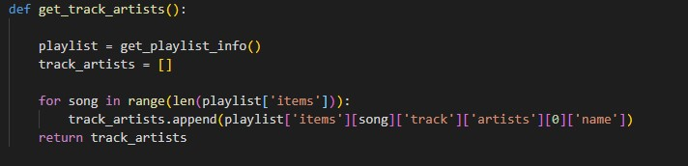
get_track_artists():
This function uses the playlist json response and searches for track artist names.
It then returns a list of track artist names.

Slide 47
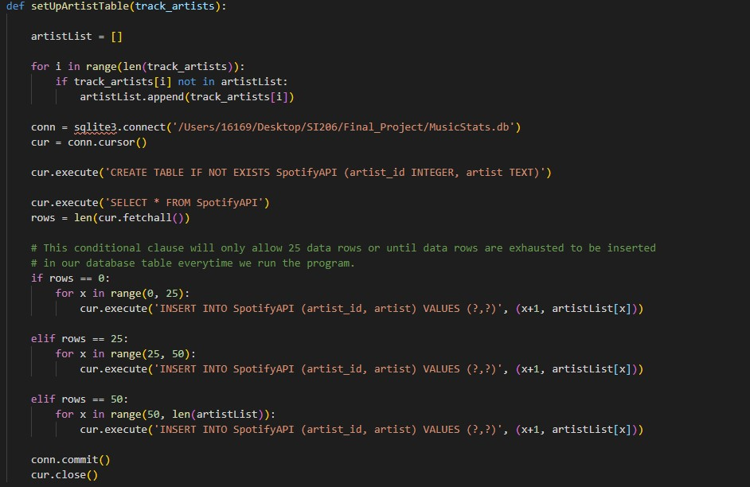
SetUpArtistListTable

Slide 48
SetUpArtistTable (Cont’d)
This function takes a track artist list to create the SpotifyAPI database table.
THe database table houses each Unique artist with a unique artist key.

Slide 49
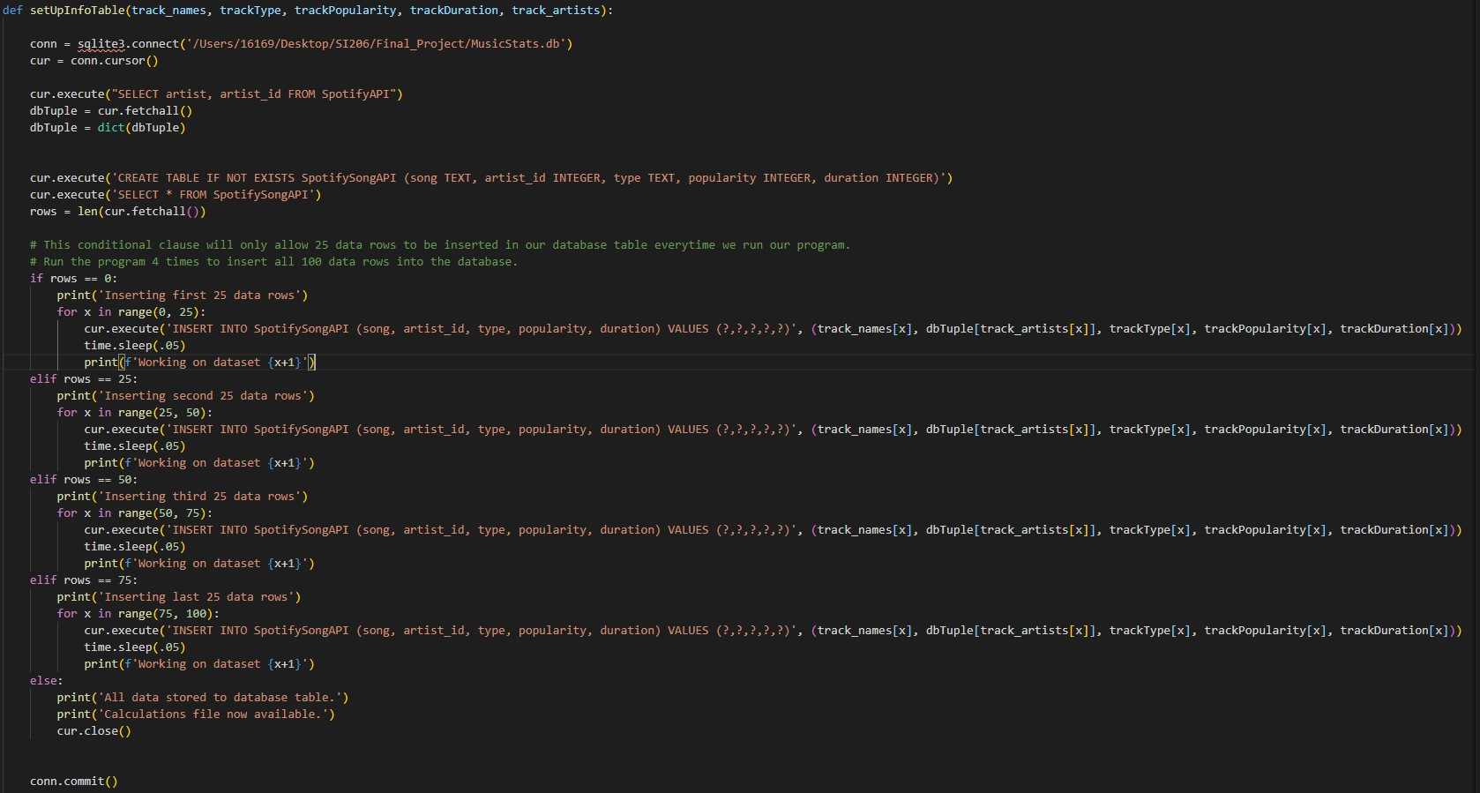
SetUpInfoTable

Slide 50
SetUpInfoTable(Cont’d)
This function takes a track name list, a track artist list, track album type, track duration list, and a track popularity list to create the SpotifySongAPI database table.
This function also selects artist and artist id data from SpotfiyAPI table so we can insert it into the new SpotifySongAPI table.

Slide 51
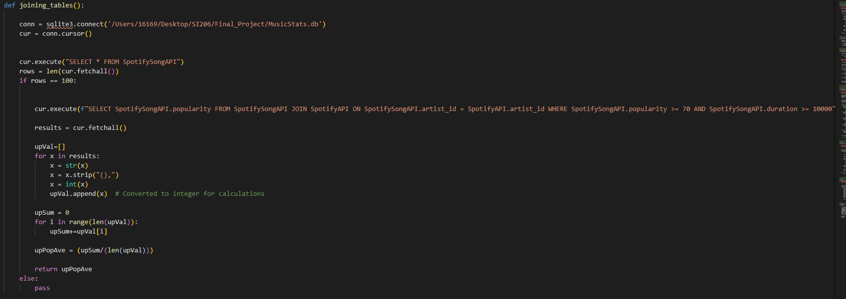
Joining_tables():

Slide 52
joining_tables (Cont’d)
This function uses the Select and Join methods to combine data tables to select popularity data that is greater than or equal to 70 and is longer than 10000 ms in duration.

Slide 53
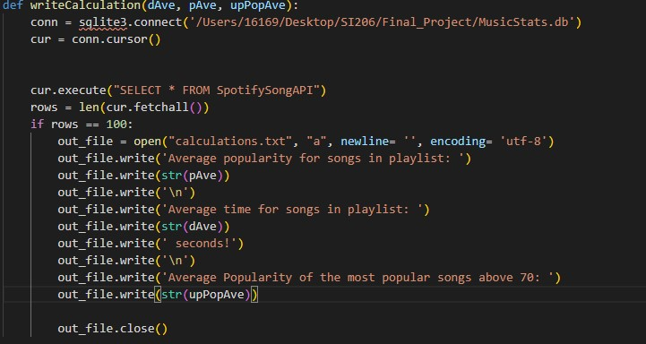
Def writeCalculation

Slide 54
Def writeCalculation (Cont’d)
This function takes in data calculations: duration average, popularity average, average popularity of the most popular songs and writes the calculations to a text file.

Slide 55
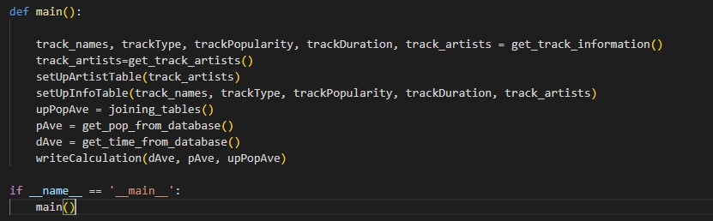
main:

Slide 56
Main (Cont’d)
The Main function calls all our functions and write to a text file a few of our calculations.

Slide 57
Beautiful Soup.py

Slide 58
Beautiful Soup.py
The following two slides includes the documentation of our BeautifulSoup file.
We start by Webscrapping the Billboard 100. We do so by targeting specific span classes writing the chart to find the position on the billboard, the song names, the name of the artists, and number of weeks on the billboard.
We then calculate the ratio of the number of weeks a song was on a billboard and put it in comparison with number of weeks in a year.
We then insert our retrieved data into the Hot100 database table, ensuring that we only allow 25 data rows to be inserted at a time using conditional clauses.

Slide 59
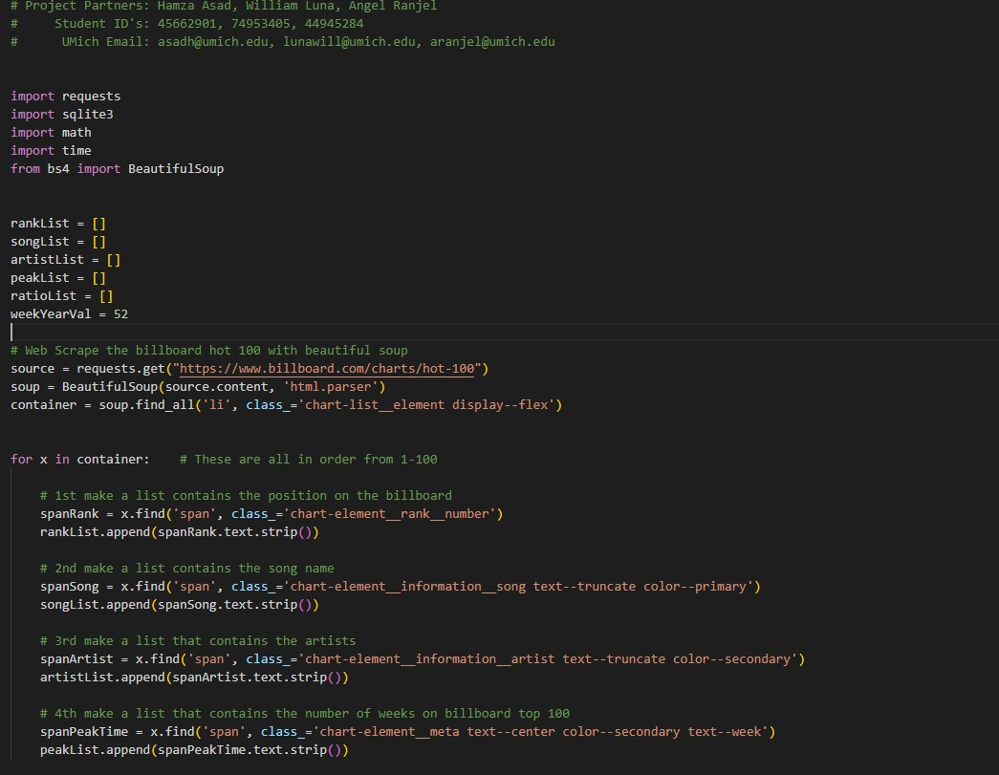
Beautiful Soup

Slide 60
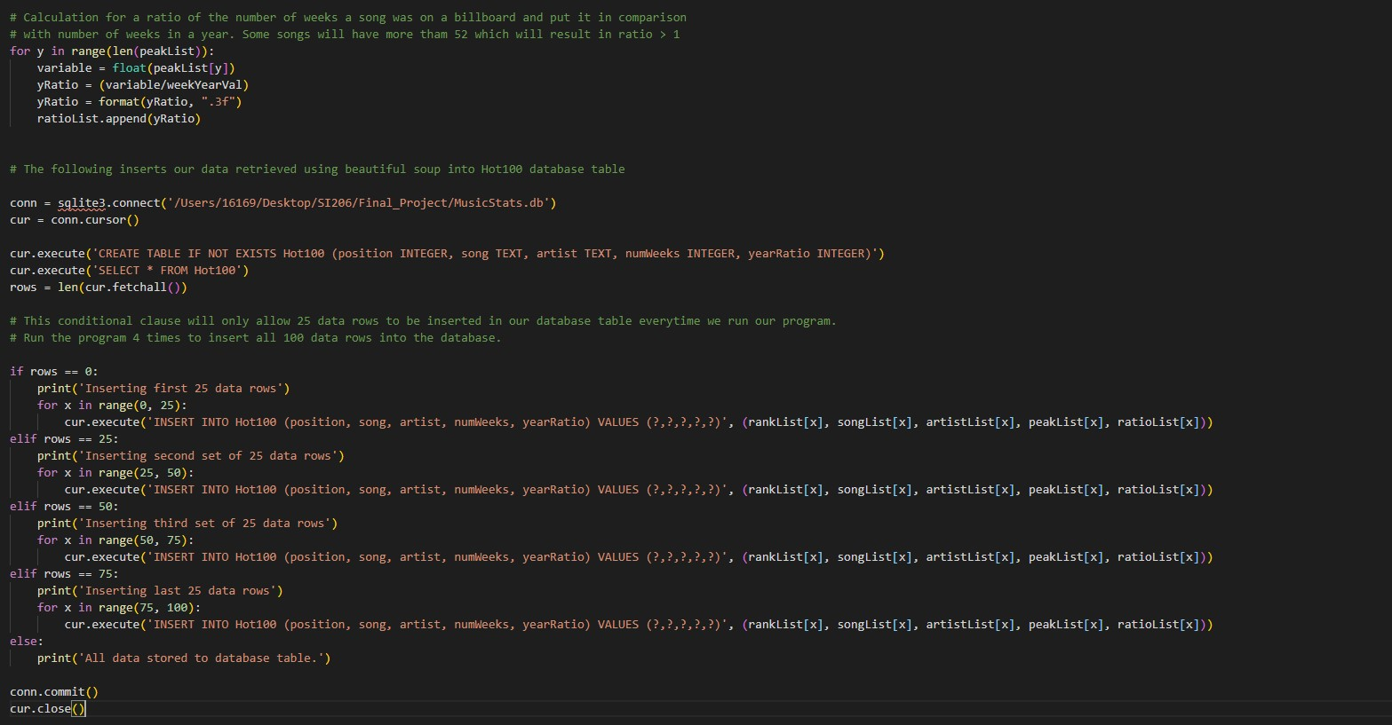
Beautiful Soup(Cont’d)

Slide 61
Documentation of Resources Used

Slide 62
Date Issue Description Location of Resource Result (did it solve theissue?)
Dec 7
Dec 7
Dec 7
Needed resource to understand Spotify’s API python specific library Spotipy
Had issues understanding the playlist JSON response from Spotify and needed more familiarity with the API
Had issues understanding the Genius search JSON response and needed more familiarity with the API
https://spotipy.readthedocs.io/en/2.16.1/
https://developer.spotify.com/documentation/web-api/reference/playlists/get-playlist/
https://docs.genius.com/#search-h2
Helped us understand the Spotipy library better and how to talk to Spotify API
Helped us better read the JSON response and identify data values needed to grab
Helped us better read the JSON response and identify data values needed to grab

Slide 63
Thank you!
Notes:
Blake

